Slide 1


CAPSTONE PROJECT
Final Review Presentation
Project : Marketing & Sales Application of AI using Chatbots (NLP) and Deep learning (ANN)
Presented By –
Chiraag Kumar 12120055
Jhanvi Sharma 12120086
Kartikey Rai 12120014
Shruti Jain 12020094
Swati Yadav 12120084

Slide 2
CONTENTS
Business Problem
Business and Data Requirement understanding
Adopted Data Architecture
Data Preparation
Modelling Techniques
Evaluation Phase
Deployment Phase
Monitoring and Maintenance

Slide 3
BUSINESS PROBLEM AND SCOPE
Insurance Policy Application/Renewal Forecasting
Business Problem
Challenge in identifying new customers and existing customers to upsell, cross sell
Business Objectives
Analyzing and identifying customer segments to boost revenue generation via cross selling and up selling insurance products. Help in customer acquisition and retention (timely premium payments on yearly basis)
Business Constraints
Scarce data availability, maintenance of System.

Slide 4
BUSINESS AND DATA REQUIREMENT UNDERSTANDING
Data Shared:
Fresh Data of March and April 2021 (6L+ customers, 24Entities)
Renewal in March and April 2021 (85K+ customers, 24 Entities)
Last Group’s Project Reports.
Business Success Criteria – Maximise customer onboarding/ Increasing active customers for renewals
ML Success Criteria –
Accuracy score > 0.85
Economic Criteria – Maximise the ROI of the Model and count of customers via Upselling, Cross Selling and identifying new customers

Slide 5
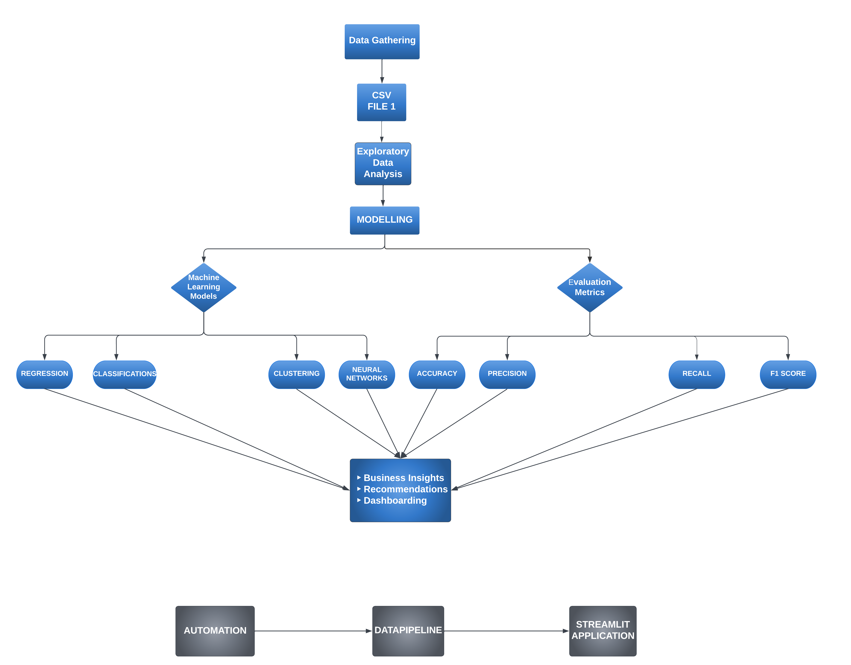
ADOPTED DATA ARCHITECTURE

Slide 6
DATA PREPARATION
Feasibility – Applicability and usability of correct ML concepts and technologies
Data Collection – Data is collected of India as our geographical location. Data will be cleaned and standardized thoroughly for further analysis for Feature Selection
Data Quality Checks – Data is divided into characters and numerical values like states, cities, categories, age, model. ex-showroom price
MODEL SELECTION –
The model selection is based on a data pipeline which runs multiple suitable models on the provided data and produces results. Based on these results, the model which provides the highest accuracy score will prove to be the most suitable for our data.

Slide 7
DATA PREPARATION
STANDARDIZATION OF DATA
Certain binary columns (Eg:- age) we mapped with respective numeric value.
All categorical features were label encoded.
CONSTRUCTION OF DATA
Feature Engineering – Data would be grouped together based on geographical location
Range and buckets would be included for categories (including commodities) and prices
Data Augmentation – Data will be augmented to train the model on larger data set of Pan India level
While doing EDA, we have plotted different charts to see and unfold information around variables in our dataset. We could see that renewal rate is very less. Some of the major points are:
We have most of the data/customer from Uttar Pradesh
Bikes are more famous among Males than females and hence more gender specific
Age wise distribution shows young buyer
Interestingly, income range with most population lies in 5k-10k with majority of self employed people
Splendor + BS6-I3S DRS seemed to be the most likeable model and ICICI Lombard General insurance has more popularity

Slide 8
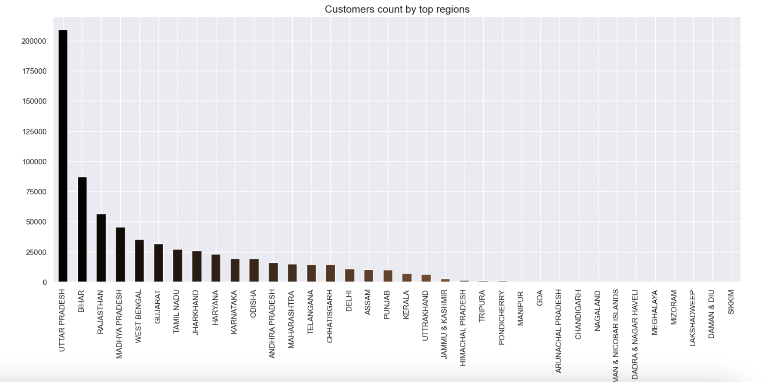
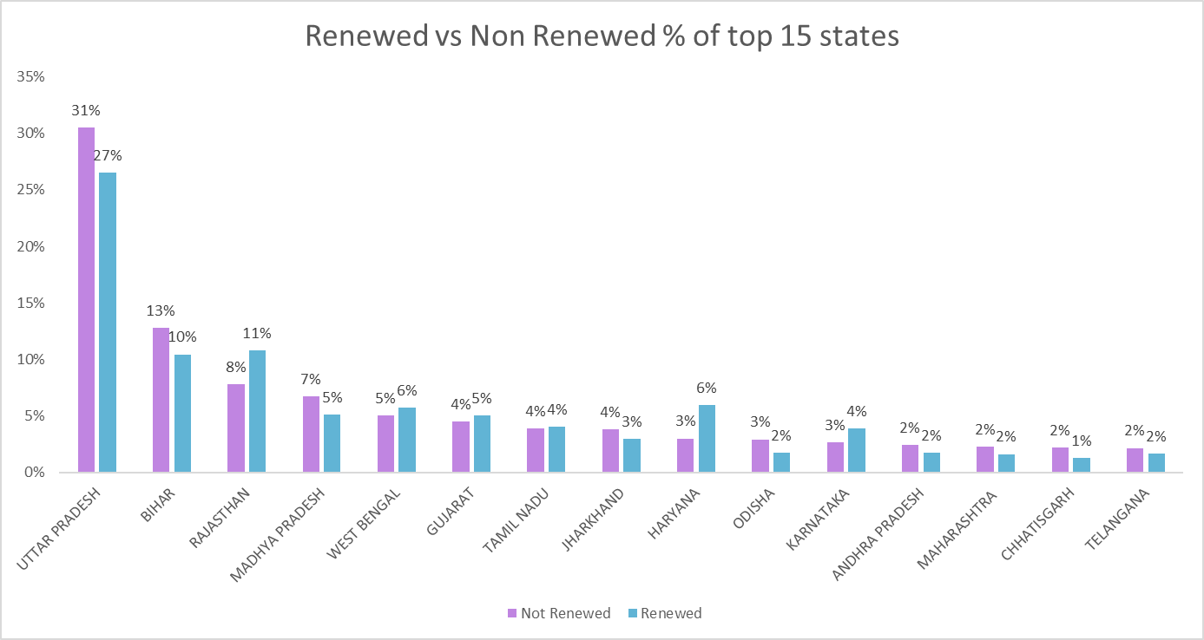
EXPLORATORY DATA ANALYSIS
Below charts depict customer data divided based on their occupation. We observe the % of renewals v/s non-renewals, where we can see Uttar Pradesh with the highest no of non-renewal customers and renewal customers, i.e. 31% and 27% respectively followed by Bihar and Rajasthan.
Notes:
Customers count by top region:

Slide 9
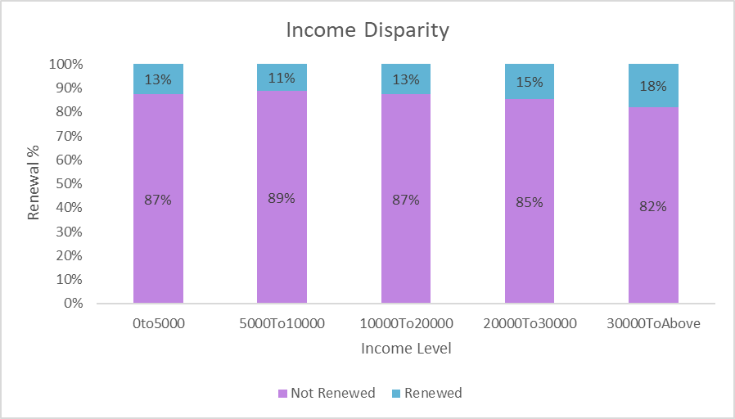
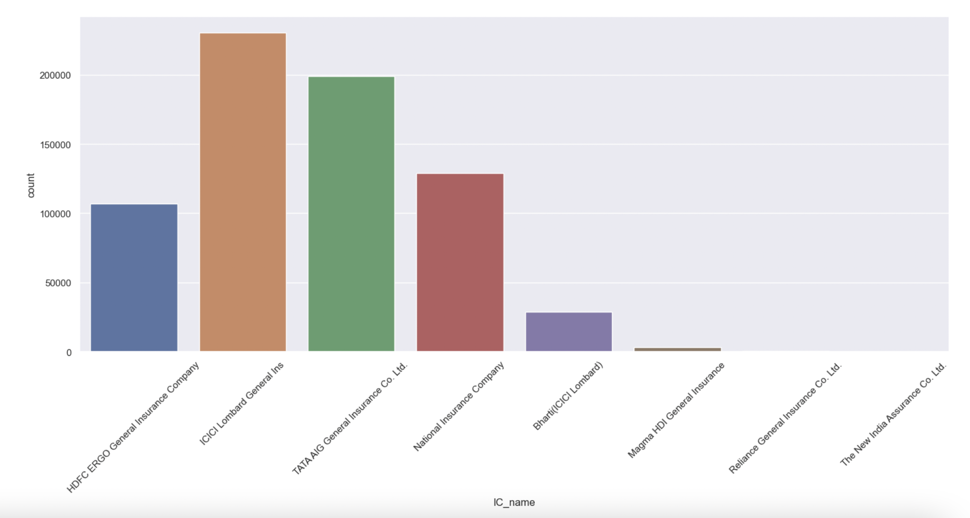
EXPLORATORY DATA ANALYSIS
Based on Income Disparity, we have below charts depicting 5 ranges of income levels divided amongst customers who have renewed and not renewed their insurances. We can observe customers belonging to 30000 and above have the highest % of renewals i.e. 18% of the respective income level.

Slide 10
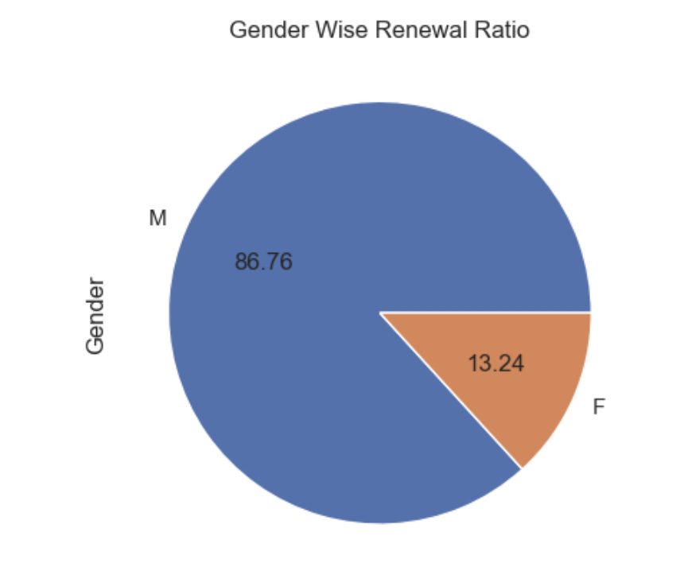
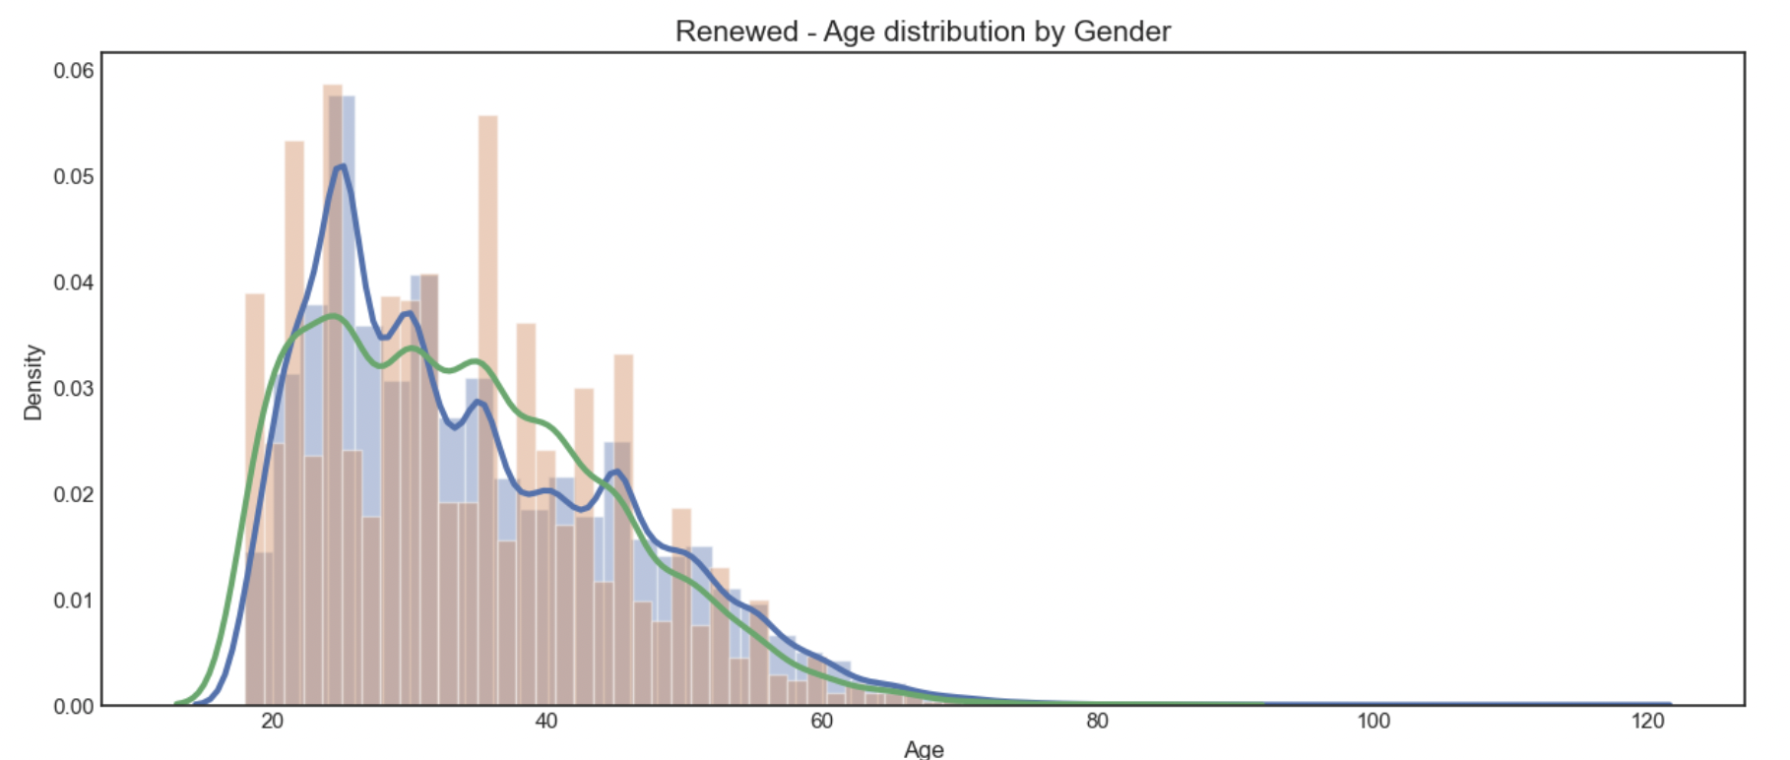
EXPLORATORY DATA ANALYSIS
Based on Renewals, we have below charts depicting Gender ratio and Age distribution by Gender. Left chart shows that Males are more into renewals than Females with huge difference. Right side chart is left skewed and shows that renewals are done more in young age for both the genders.
Gender wise Renewal Status
Gender Wise Age wise Renewal Status

Slide 11
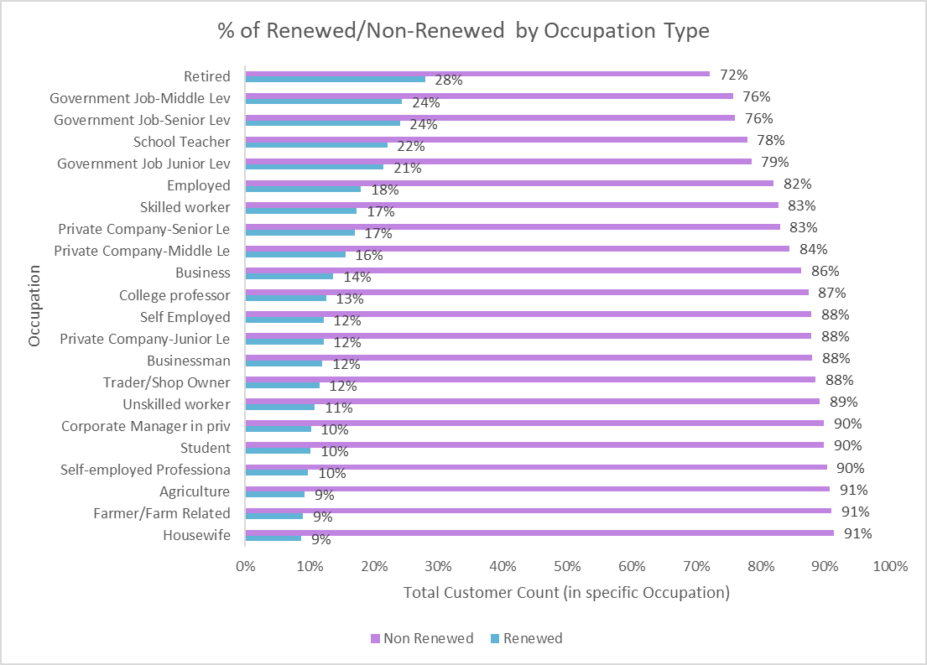
EXPLORATORY DATA ANALYSIS
Based on occupation type, we can observe the % of renewals and non-renewals in each specific occupation type. For eg, in Govt job – mid level management occupation, we can observe that 24% of the customers with this occupation have renewed their insurances v/s 76% have not renewed.

Slide 12
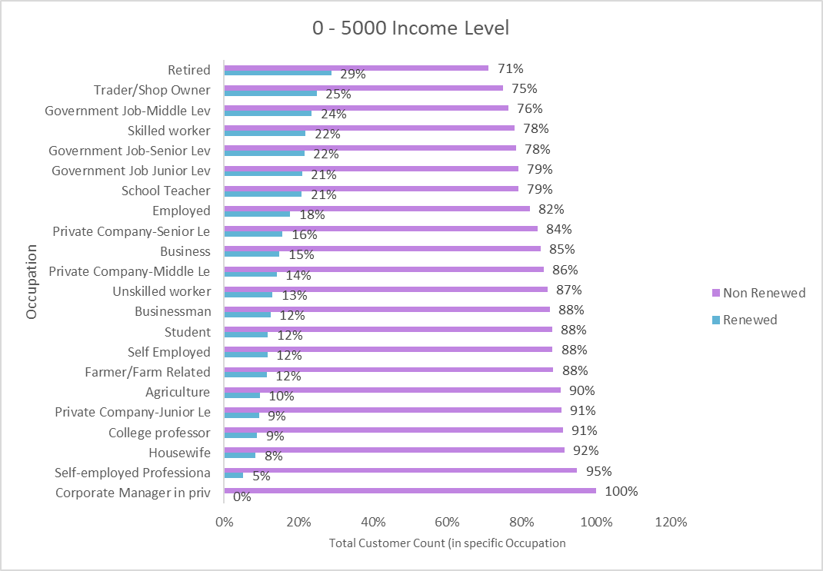
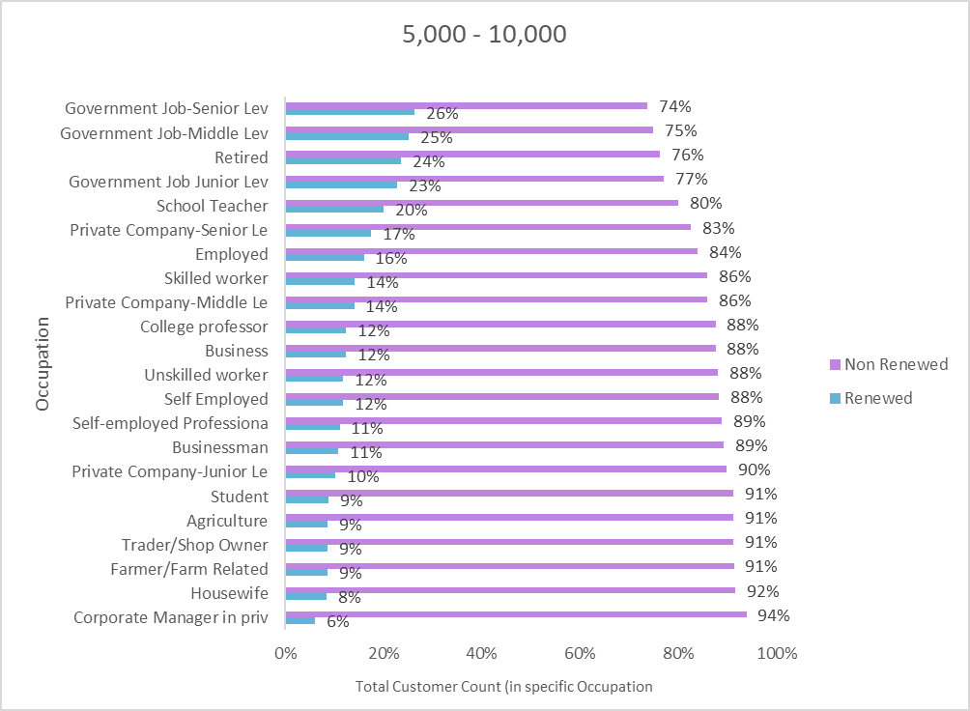
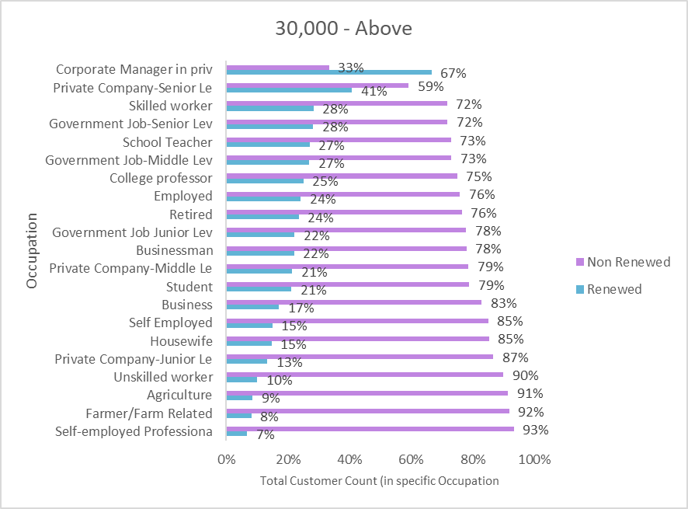
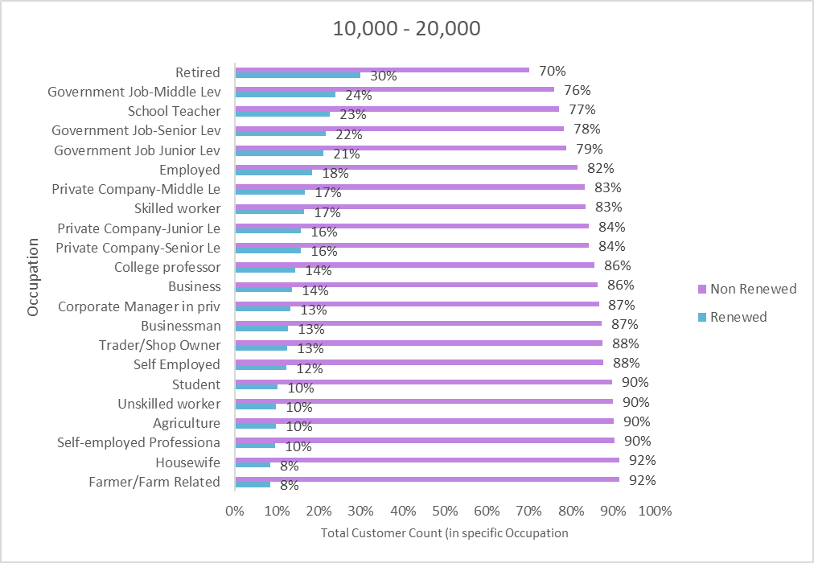
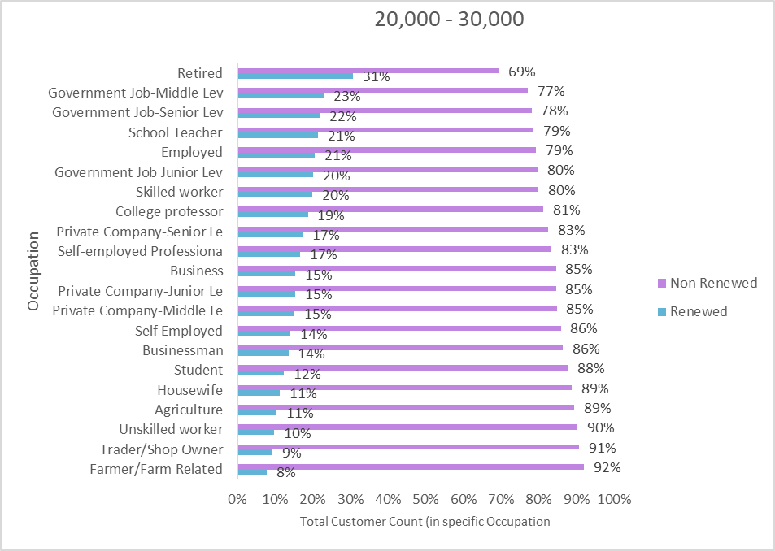
EXPLORATORY DATA ANALYSIS
Occupation type analysis is further drilled down based on all the income levels and the occupation types each level consists of.
Below we can observe that customers with 30000 or above income level have the highest rate of renewal insurances with Corporate management being highest on the list with 67% of the customers who got their insurances renewed.
0 – 5000 Income
5000 – 10000 Income
10000 - 20000 Income
20000 - 30000 Income

Slide 13
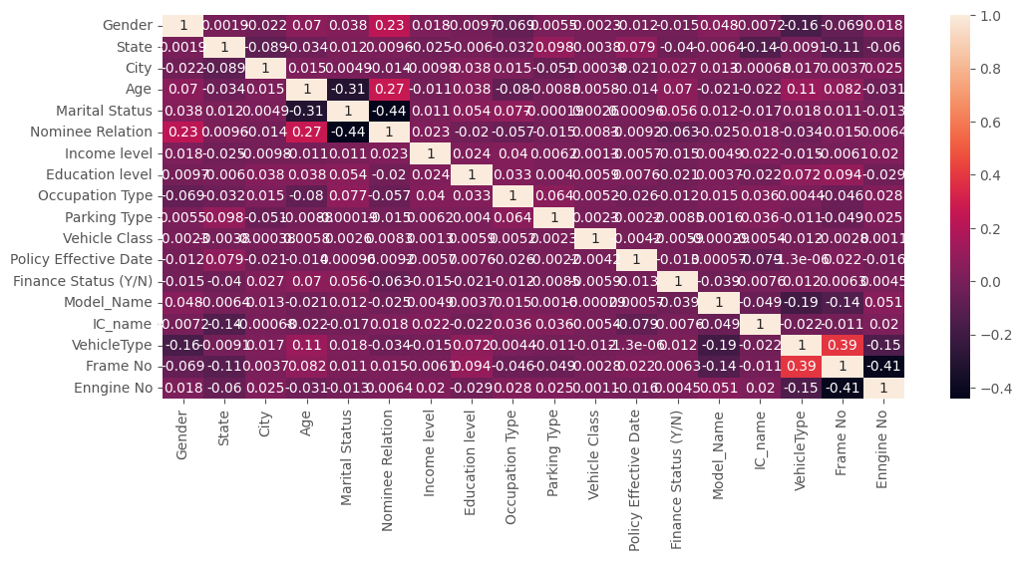
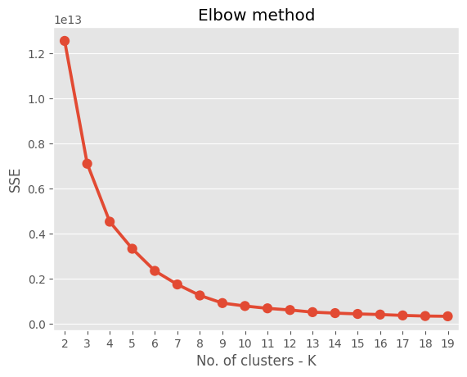
Consumer Insights
We find that there is very low correlation between the features.
There would be 6 relevant clusters by K Means Clustering
25% of insurance sales in Bihar is of SPLENDOR + BS6-I3S DRS with only 9% renewal
33% of insurance sales of Madhya Pradesh is HF DELUXE-BS-6
50% of UP uses the top 4 Models i.e. SPLENDOR + BS6-I3S DRS, HF DELUXE-BS-6, HF DELUXE-BS-6, SUPER SPL BS6

Slide 14
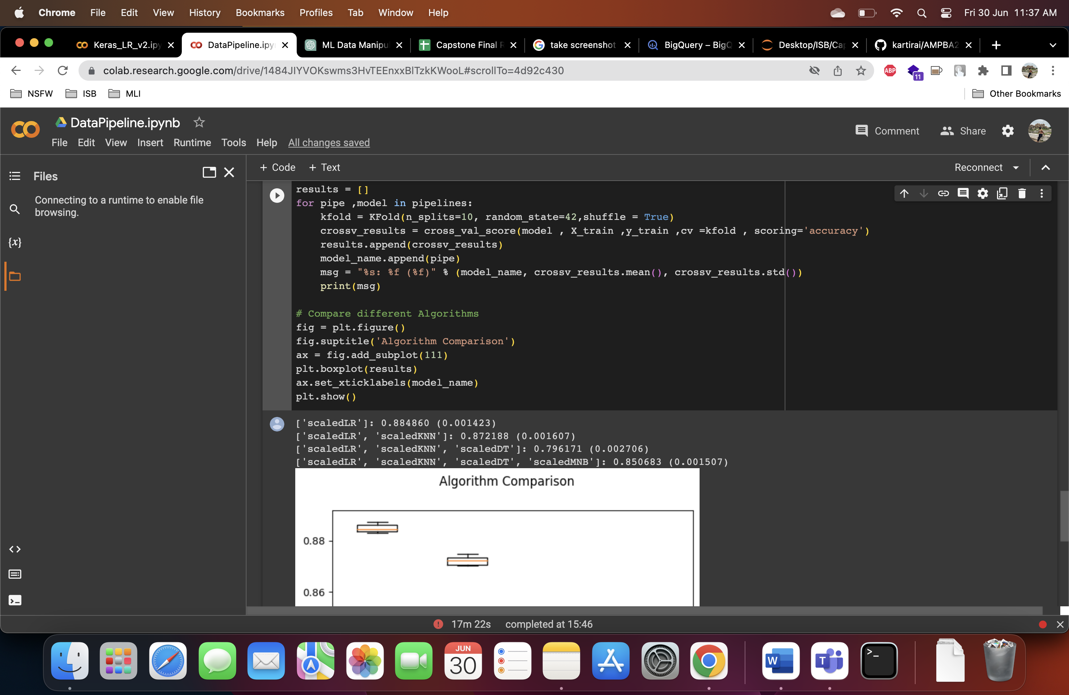
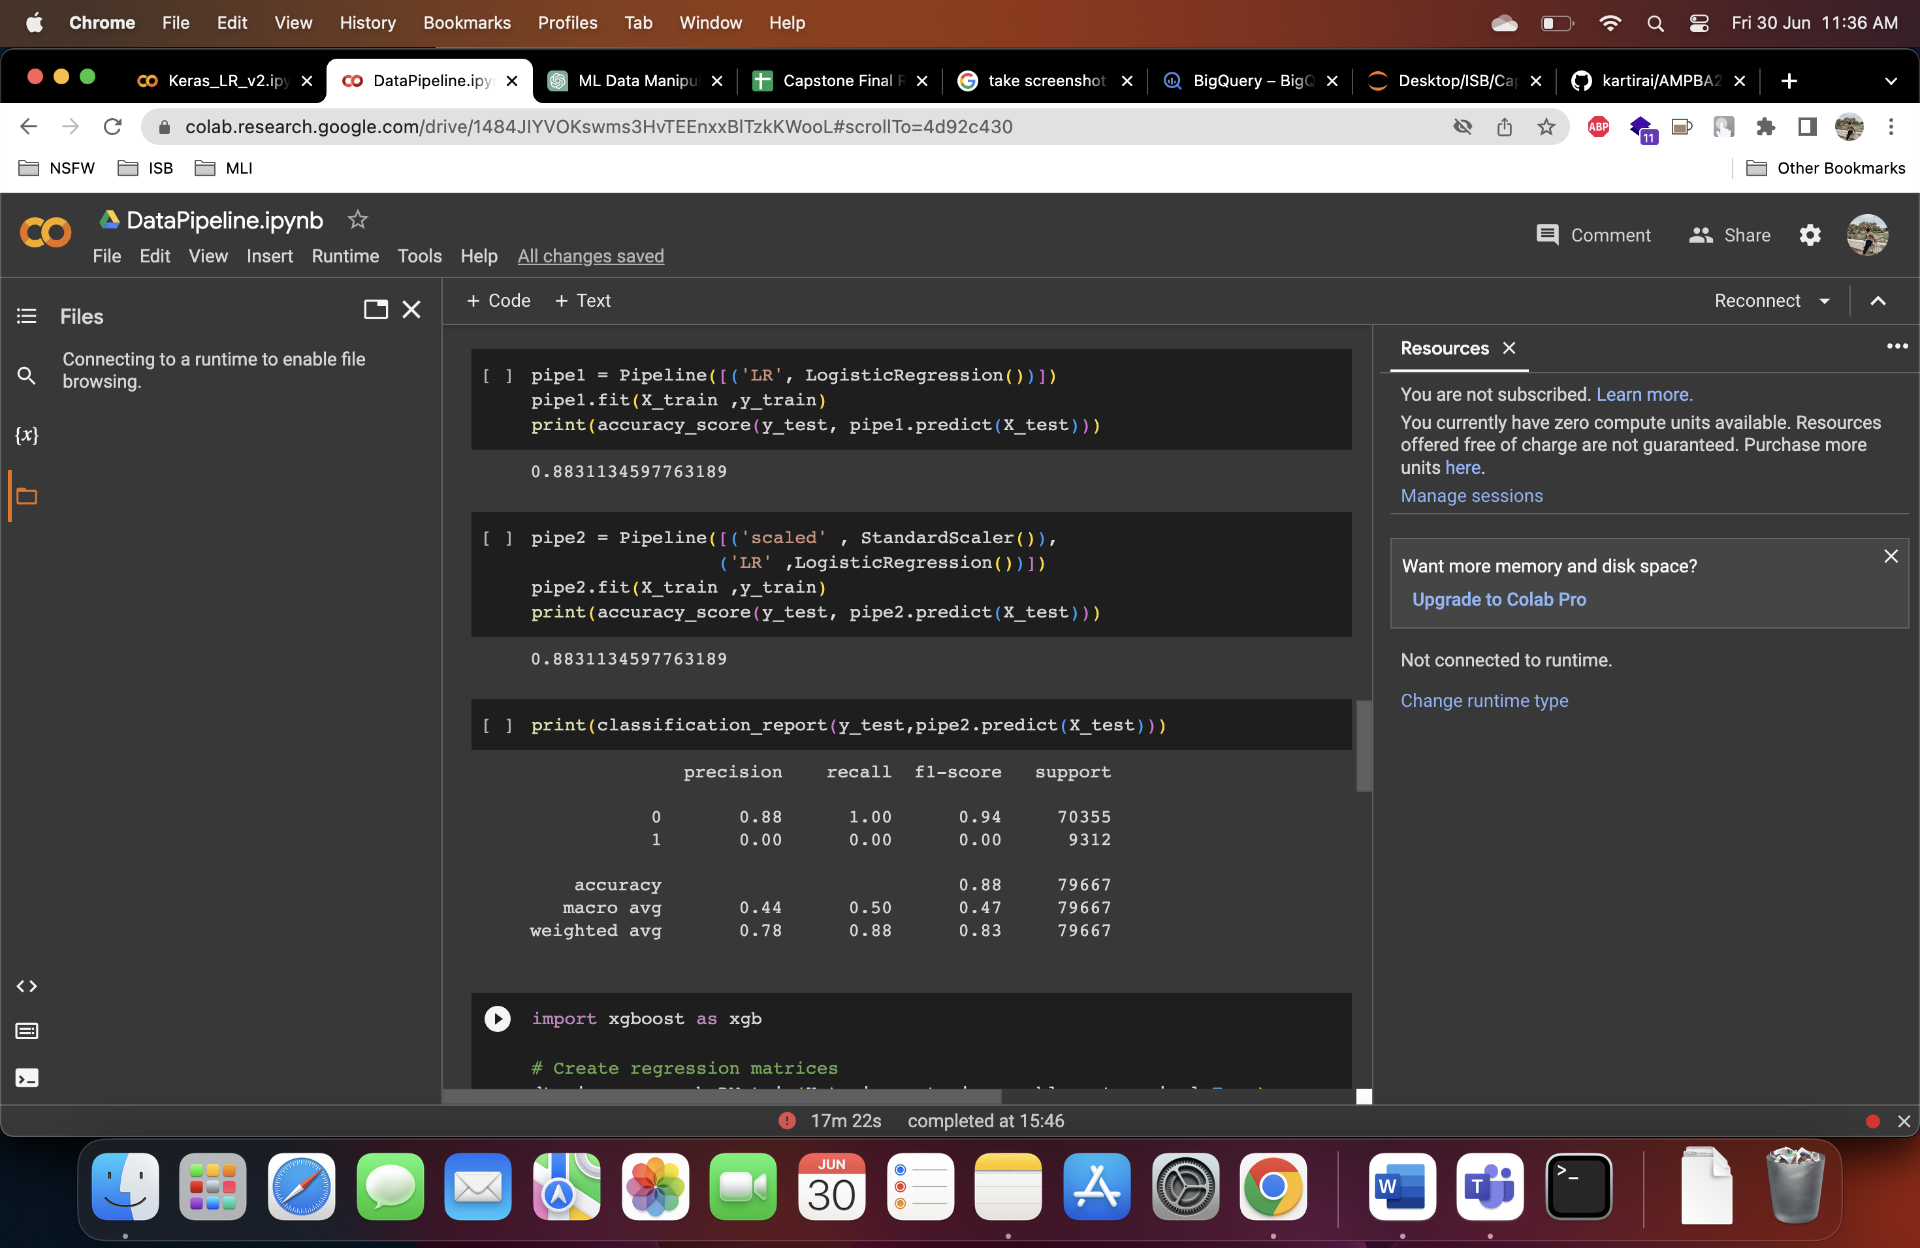
Data Pipeline Creation with XGBoost Library
- Data pipeline creation using XGBoost library. - Execution of four models and recording their accuracy.
Model Evaluation: - Logistic Regression: - Accuracy: 0.88 (highest accuracy). - K-Nearest Neighbors (KNN):
- Accuracy: 0.87. - Decision Tree: - Accuracy: 0.79. - Gaussian Naive Bayes (NB): - Accuracy: 0.85.

Slide 15
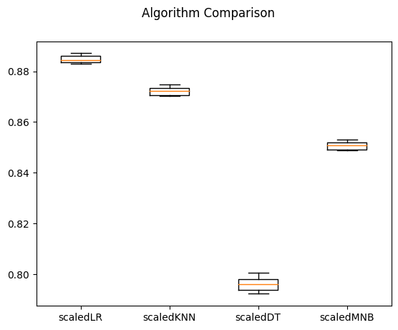
Logistic Regression achieved the highest accuracy of 0.88.
KNN performed well with an accuracy of 0.87.
Decision Tree yielded an accuracy of 0.79.
Gaussian NB achieved an accuracy of 0.85.
Key Takeaways:
Logistic Regression is the most accurate model for this dataset.
KNN also performs well as a reliable alternative.
Decision Tree and Gaussian NB provide lower accuracy but may have other benefits or use cases.

Slide 16
MODELLING TECHNIQUES
Data Manipulation in Excel:
Imported and merged data sets using V-lookup
Aligned data points to create a single data file
Exploratory Data Analysis (EDA) in Excel & Python:
Dropped unnecessary columns and sliced data
Prepared data for model creation
Model 1: Logistic Regression:
Features (X) and renewal status (Y)
Split data into 80% training and 20% test sets
Achieved 87.7% accuracy
Mean Squared Error = 0.123

Slide 17
MODELLING TECHNIQUES
Model 2: Deep Learning with TensorFlow and Keras:
Sequential model with 3 dense layers
Layer details: 24, 16, and 1 neurons respectively
Used ReLU and sigmoid activation functions
849 trainable parameters (432 in 1st layer, 400 in 2nd, and 17 in the last)
Compiled model with 0.05 learning rate and achieved 87.7% accuracy
Prediction and Data Storage:
Combined predicted results with engine numbers
Stored data in Google Cloud Platform's Data Lake (BigQuery)
Alternative: Pushed data to Google Sheets for visualization

Slide 18
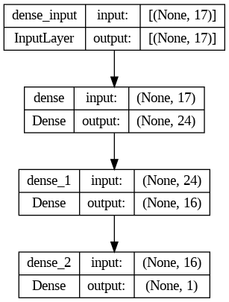
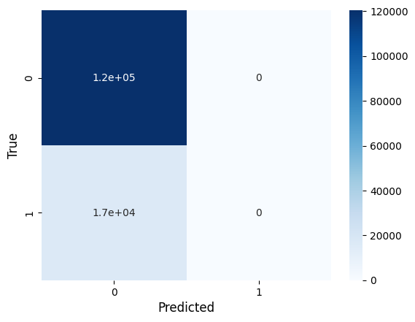
MODELLING TECHNIQUES

Slide 19
MODELLING TECHNIQUES
Data Visualization:
Utilize data in BigQuery or Google Sheets
Enable visualization using tools like Tableau, Power BI, Google Data Studio, etc
Benefits:
Centralized data storage and retrieval
Flexibility in choosing visualization tools
Enhanced decision-making through visual representations

Slide 20
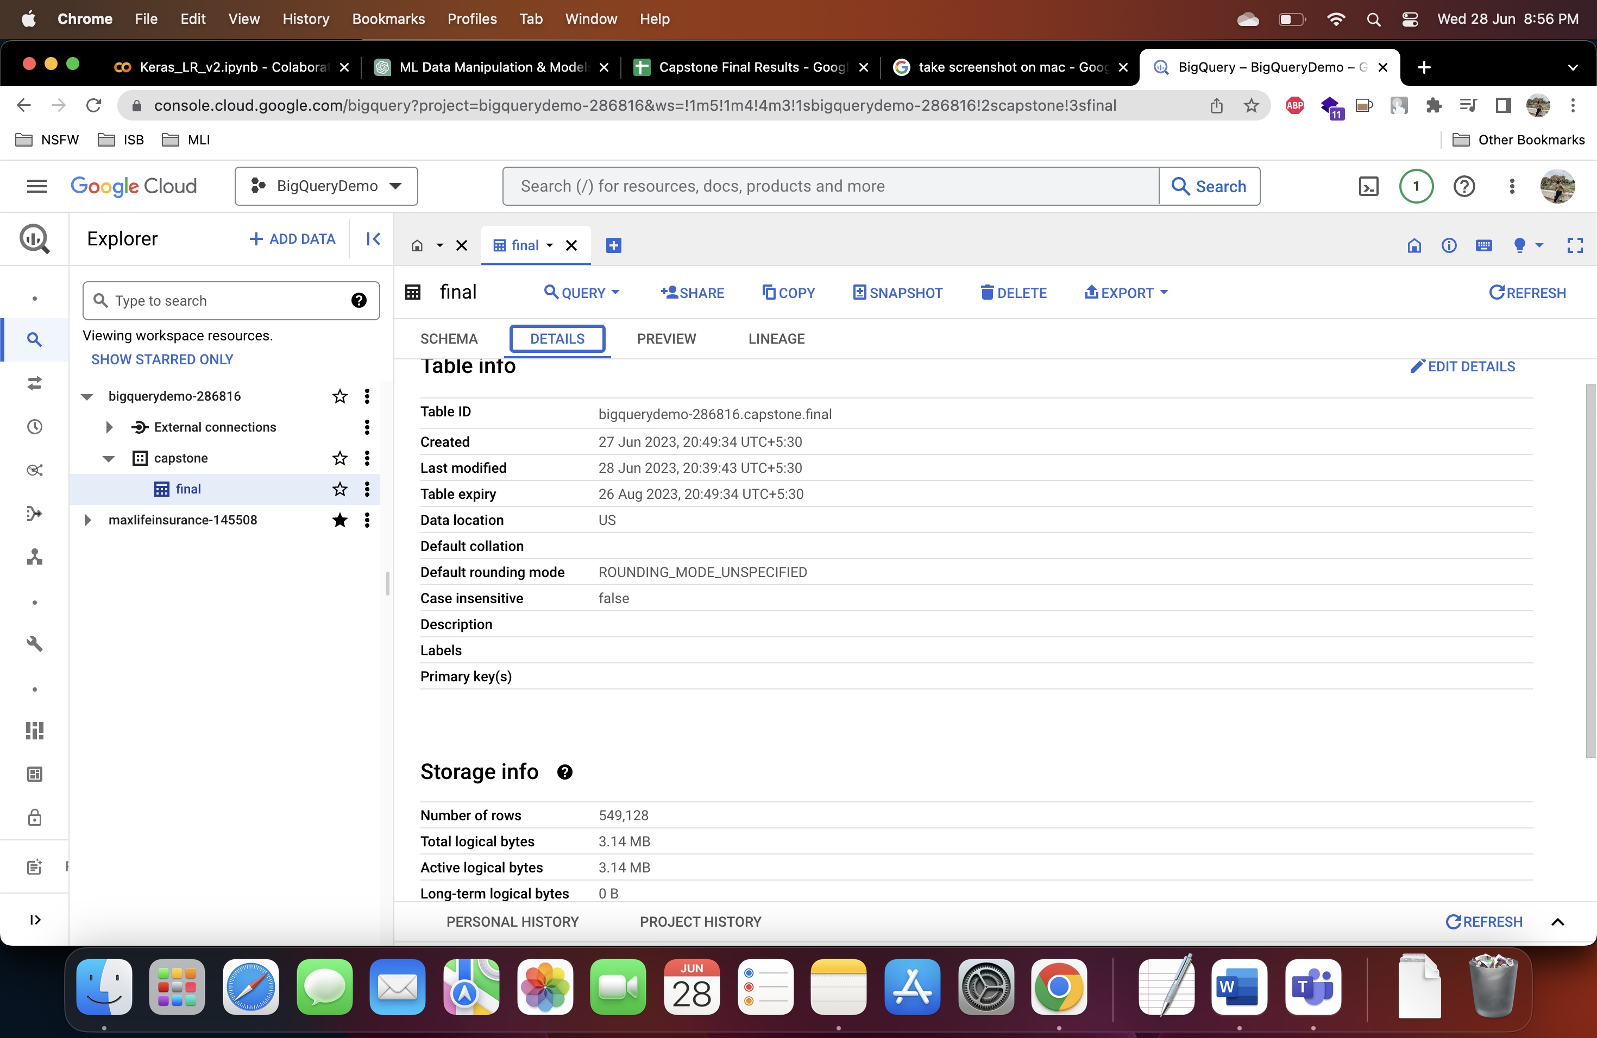
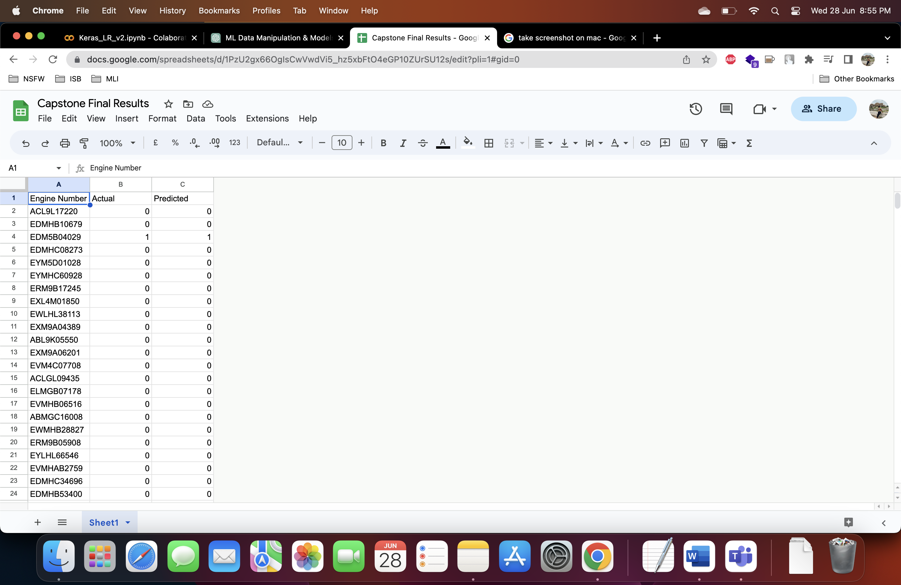
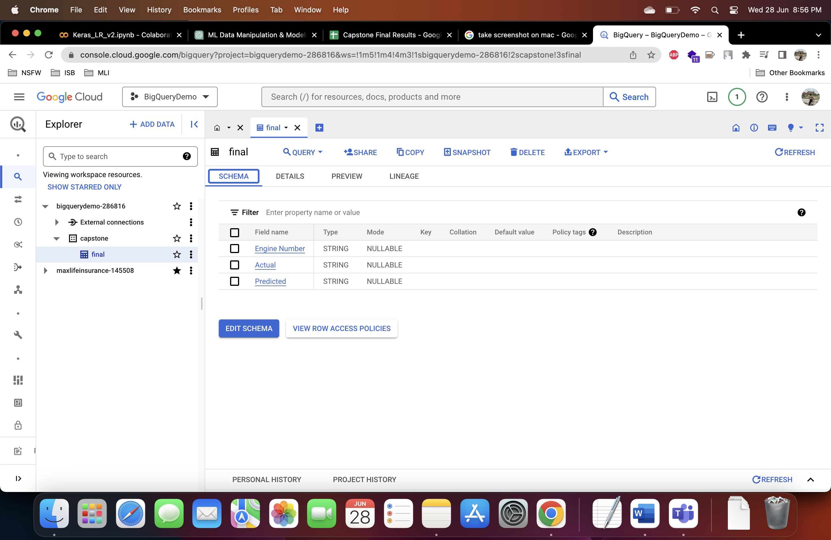

Slide 21
EVALUATION PHASE
VALIDATION & ACCURACY
To be conducted with the real time data for defined measures of success criteria, which will also ensure robustness of the model and predicted accuracy is achieved
Test Results –
Accuracy

Slide 22

DEPLOYMENT PHASE

Slide 23
DEPLOYMENT PHASE
Unforeseen Errors –
Additional error checks will be conducted for data quality once deployment stage is achieved
Deployment Strategy –
Deployment strategy will be based on certain categories to be used for analysis and then followed by all categories data analysis
Regular and periodical checks and updates to be mandated and debugging

Slide 24
MONITORING AND MAINTENANCE
Constant system updates will be required and done to ensure all monthly data is getting stored properly
Automation will also assist in faster results to ensure the model doesn’t slow down due to heavy data processing
Data drift to be addressed by retraining the model with recent data periodically and use model performance monitoring tools to monitor the model and set triggers in case of model drift
Further explore and fine-tune the logistic regression model.
Investigate potential optimizations for the KNN model.
Assess the usefulness of the decision tree and Gaussian NB models in specific scenarios.

Slide 25
THANK YOU

